Slide 1
Integrated Learning Environment for ‘Programming with Functions’

Slide 2
User
Selected Language
Csharp
Expression evaluation
Task – 1372
> Square(3 + 4)
49
Define a function named Square which takes in an integer number and returns the square of that number.
For this task you may use any arithmetic operators, but no ready-made functions.
4 marks available
>
Submit completed task
Request next hint (1 mark)
Hint #1
Type Square(Type variableName) => expression;
Function definition
Copy this code template but replace the highlighted text with the code
int Square(int n) => n * n;
Request next hint (1 mark)
Testing
This task defines automated tests, which must all pass before the task may be submitted. The Run Tests button is enabled only once function definition(s) have been written, submitted, and successfully compiled.
Submit
Run Tests

Slide 3
User
Selected Language
Csharp
Expression evaluation
Application – Squares Game
> Square(3 + 4)
49
Now that you have successfully written and tested the Square function, we can use it this application to [blah]. Click Run and then follow these instructions [blah].
Run
>
[application screen]
Function definition
int Square(int n) => n * n;

Slide 4
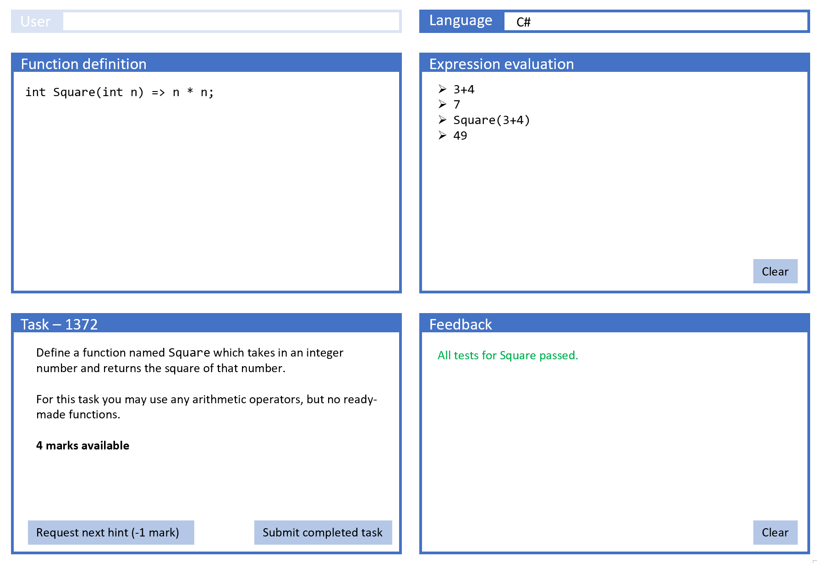
Client
Written in Angular
Combines some standard NOF views of Admin functionality with custom UI framework for programming tasks
TypeScript
Generic framework
Task-specific code, may include. example application (common to all user languages)
User-language specific (task generic) glue code
User language (Python, C#, VB.NET, Java, …)
User-entered expression
User-entered functions
(Hidden) wrapper-code, task specific but templated
Send: Programming language + user source code (with templated wrapper code)
Returns: Console output generated by successful execution, or compile / runtime errors
Given a task ID serves up whole page including all TypeScript files and (hidden) task-specific & generic wrapper code in user language.
Log-on
View assigned tasks
Record progress/marks
JOBE Server
(PHP on Linux)
Content-management system
One server
Administration system
(Naked Functions)
https://github.com/trampgeek/jobe#using-jobe
Need to add Mono templates for C# & VB.NET
Objects: Teacher, Student, Task, Assignment, …

Slide 5
Client: main code elements
Key:
TypeScript
User Language
Text or html
Separate version for each User Language
Separate version for each User Language
Written by framework developers
Generic client framework
Loads complete Task set-up
Wrapper code for expression, function defs, tests (as appropriate) – to submit to JOBE
callUDF<T> and various type-rendering helper methods for invoking user-defined function with arguments from App
Each invocation is via JOBE, with functions and invocation as an expression
Parses the returned value into type T
Test runner
Wrappers for expression and/or function definitions – to submit to JOBE
Hint and Marks management
Parsers for return messages from JOBE:
Extract/reformat/transform text elements
Post into Evaluator or Feedback panes
Set client states (control various buttons)
Parsers for return messages from JOBE:
Extract/reformat/transform text elements
P
Application runner
Written by task author
Task description
List of disallowed functions/patterns
Applies to both expression and UDF pane
Implemented as RegEx patterns
White list of usable functions
Applies to both expression and UDF panes
May be individual fully-qualified functions
Hints (optional)
Tests (optional)
Hints
Starter code for Function definitions (optional)
App code (optional)
Starter code for Function definitions (optional)
User-defined functions
Written by user
Expressions

Slide 6
State management
Function definition pane knows:
whether or not current code has been submitted (to compiler)
if submitted, whether or not it has compiled successfully. (Might add a visual state indicator e.g. colour of code)
if compiled, whether or not any tests have all passed.
Upon successful compilation:
The functions may be used within expressions
if the Task defines any Tests then the Run Tests button appears (not sure whether in function pane or task pane). Run Tests disappears only if all tests have passed or if code has been edited
Upon successful test run:
if the Task defines an application, a Launch Application button will appear, which will launch the application code (which is written in TypeScript) and which will interface through calling routines to the user-defined functions.
Function definition
int Square(int
Submit
Run Tests
Launch application

